Slide 1
Methods for
3D Reconstruction from Multiple Images

Slide 2
Introduction
Increasing need for geometric 3D models
  Movie industry, games, virtual environments…
Existing solutions are not fully satisfying
  User-driven modeling: long and error-prone
  3D scanners: costly and cumbersome
Alternative: analyzing image sequences
  Cameras are cheap and lightweight
  Cameras are precise (several megapixels)

Slide 3
Outline
Context and Basic Ideas
Consistency and Related Techniques
Regularized Methods
Conclusions

Slide 4
Outline
Context and Basic Ideas
Consistency and Related Techniques
Regularized Methods
Conclusions

Slide 5
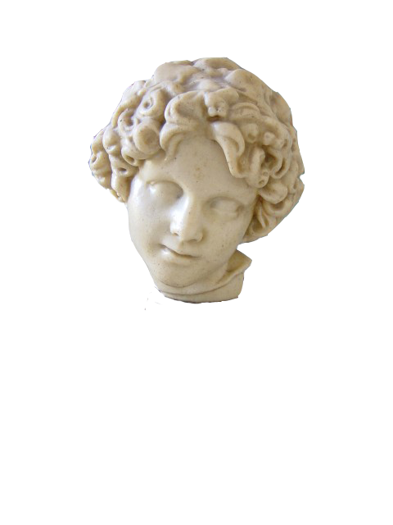
Scenario
A scene to reconstruct (unknown a priori)
Several viewpoints
  from 4 views up to several hundreds
  20~50 on average
“Over water”
  non-participating
  medium

Slide 6
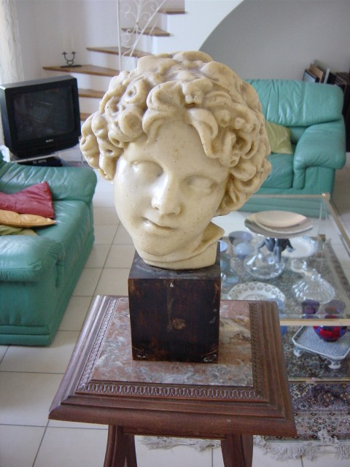
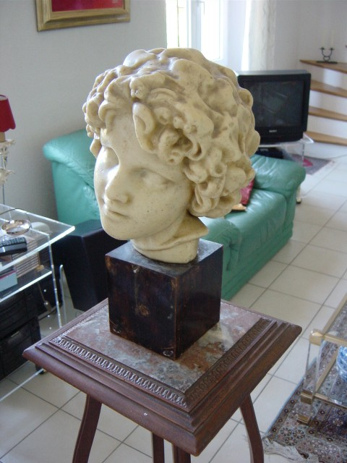
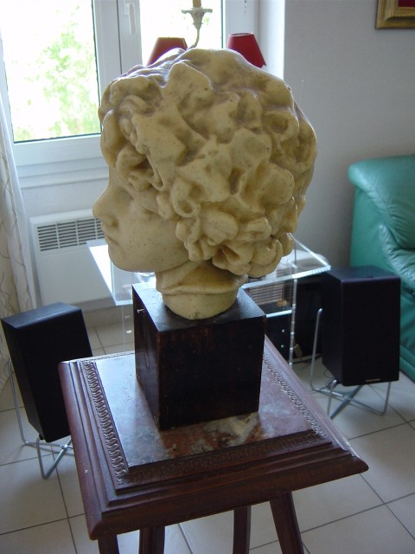
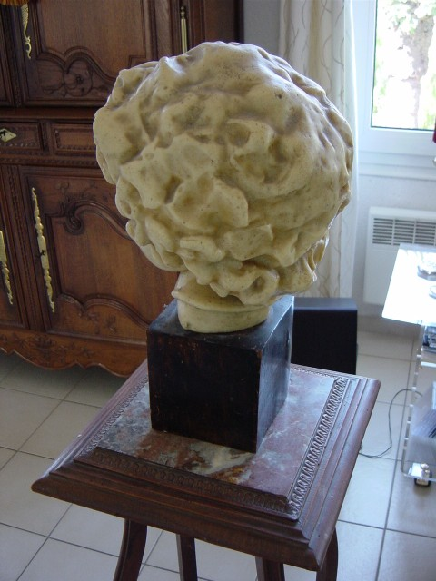
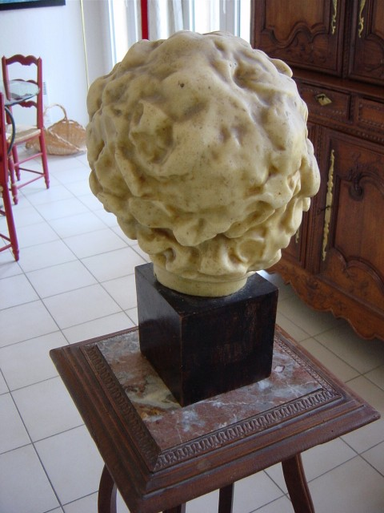
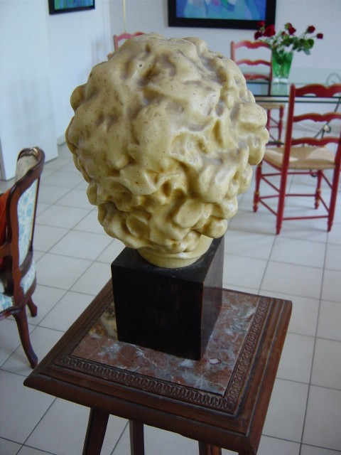
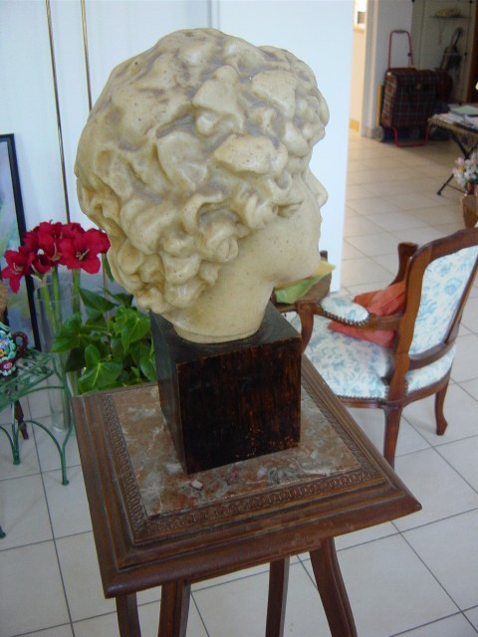
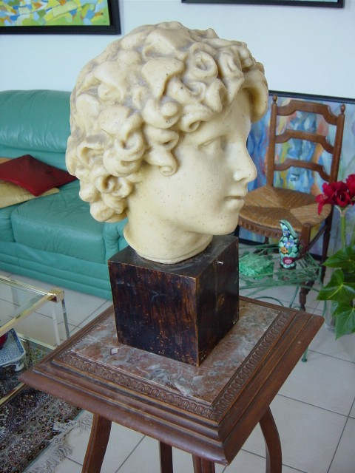
Sample Image Sequence
[Lhuillier and Quan]
How to retrieve the 3D shape?
Notes:
The image sequence is available on Long Quan’s webpage: http://www.cs.ust.hk/~quan/WebPami/pami.html

Slide 7
First Step: Camera Calibration
Associate a pixel to a ray in space
  camera position, orientation,
  focal length…
Complex problem
  solutions exist
  toolboxes on the web
  commercial software available
2D pixel ⬄ 3D ray

Slide 8
Outline
Context and Basic Ideas
Consistency and Related Techniques
Regularized Methods
Conclusions

Slide 9
General Strategy: Triangulation
Matching a feature
in at least 2 views
⇩
3D position

Slide 10
Matching First
Which points are the same?
Impossible to match all points ⇨ holes.
Not suitable for dense reconstruction.

Slide 11
Sampling 3D Space
YES
Pick a 3D point
Project in images
Is it a good match?

Slide 12
Sampling 3D Space
NO
Pick a 3D point
Project in images
Is it a good match?

Slide 13
Consistency Function
“Is this 3D model consistent
with the input images?”
No binary answer
  noise, imperfect calibration…
Scalar function
  low values: good match
  high values: poor match

Slide 14
Examples of Consistency Functions
Color: variance
  Do the cameras see the same color?
  Valid for matte (Lambertian) objects only.
Texture: correlation
  Is the texture around the points the same?
  Robust to glossy materials.
  Problems with shiny objects and grazing angles.
More advanced models
  Shiny and transparent materials.
[Seitz 97]
[Yang 03, Jin 05]
Notes:
[Seitz 97] Photorealistic Scene Reconstruction by Voxel Coloring S. M. Seitz and C. R. Dyer, Proc. Computer Vision and Pattern Recognition Conf., 1997, 1067-1073.
[Yang 03] R. Yang, M. Pollefeys, and G. Welch. Dealing with Textureless Regions and Specular Highlight: A Progressive Space Carving Scheme Using a Novel Photo-consistency Measure, Proc. of the International Conference on Computer Vision, pp. 576-584, 2003
[Jin 05] H. Jin, S. Soatto and A. Yezzi. Multi-view stereo reconstruction of dense shape and complex appearance
Intl. J. of Computer Vision 63(3), p. 175-189, 2005.

Slide 15
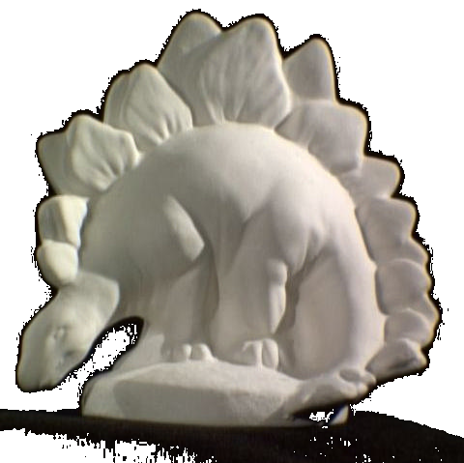
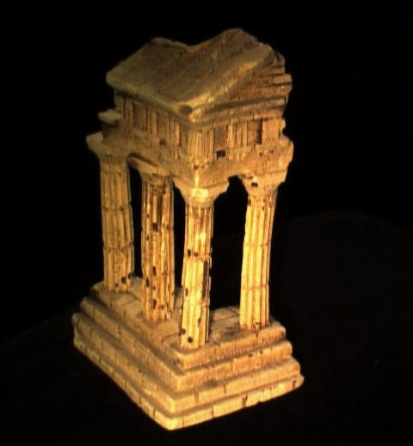
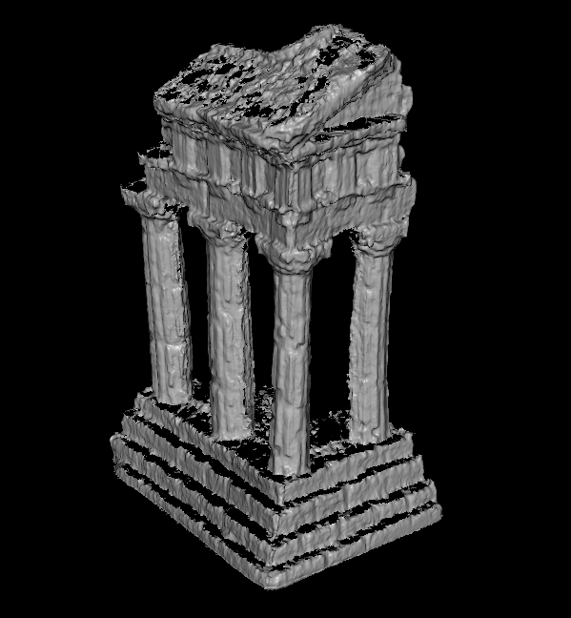
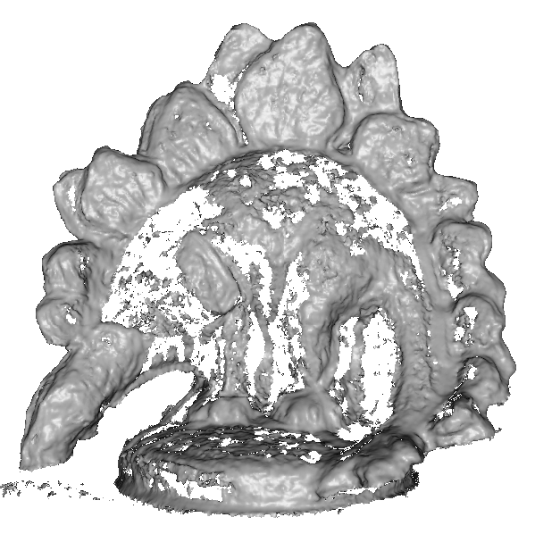
Reconstruction from Consistency Only
Gather the good points
  requires many views
  otherwise holes appear
[Lhuillier 02, Goesele 06]
input
result
input
result
[Goesele 06]
Notes:
[Lhuillier 02] ECCV'02, Quasi-Dense Reconstruction from Image Sequence. M. Lhuillier and L. Quan, Proceedings of the 7th European Conference on Computer Vision, Copenhagen, Denmark, Volume 2, pages 125-139, May 2002
[Goesele 06] Michael Goesele, Steven M. Seitz and Brian Curless. Multi-View Stereo Revisited, Proceedings of CVPR 2006, New York, NY, USA, June 2006.

Slide 16
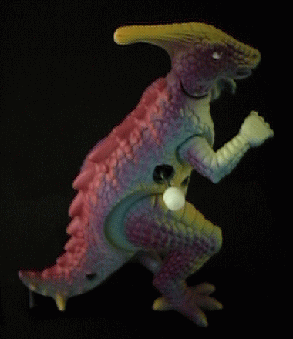
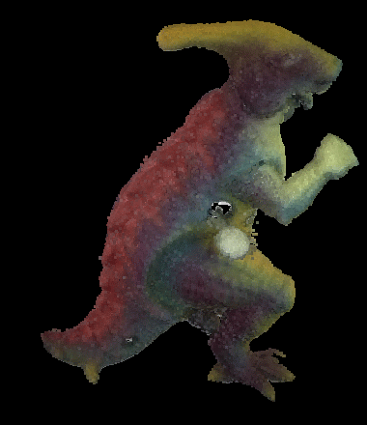
Reconstruction from Consistency Only
Remove the bad points
  start from bounding volume
  carve away inconsistent points
  requires texture
    otherwise incorrect geometry
[Seitz 97, Kutulakos 00]
input
result
[Seitz 97]
Notes:
[Seitz 97] Photorealistic Scene Reconstruction by Voxel Coloring S. M. Seitz and C. R. Dyer, Proc. Computer Vision and Pattern Recognition Conf., 1997, 1067-1073.
[Kutulakos 00] A Theory of Shape by Space Carving. K. N. Kutulakos and S. M. Seitz, International Journal of Computer Vision, 2000, 38(3), pp. 199-218

Slide 17
Conclusions
3D reconstruction is a hard problem.
Solutions exist.
  Need to be adapted to specific environment.
Consistency carries information and adds detail.
  Regularization removes noise and fills holes.
Start with a simple solution.
  A complete failure is not a good sign.

